Slide 1
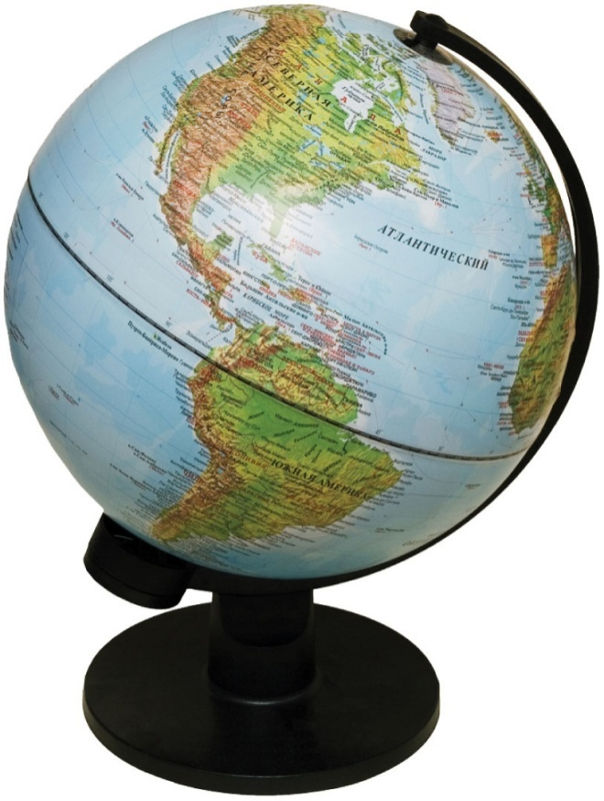
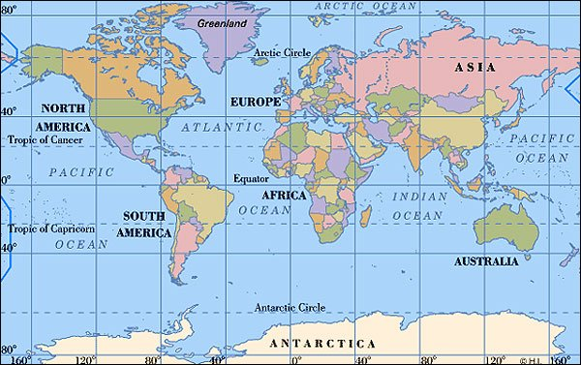


Mini-Lecture
Chapter 2
Portraying Earth
© 2014 Pearson Education, Inc.

Slide 2
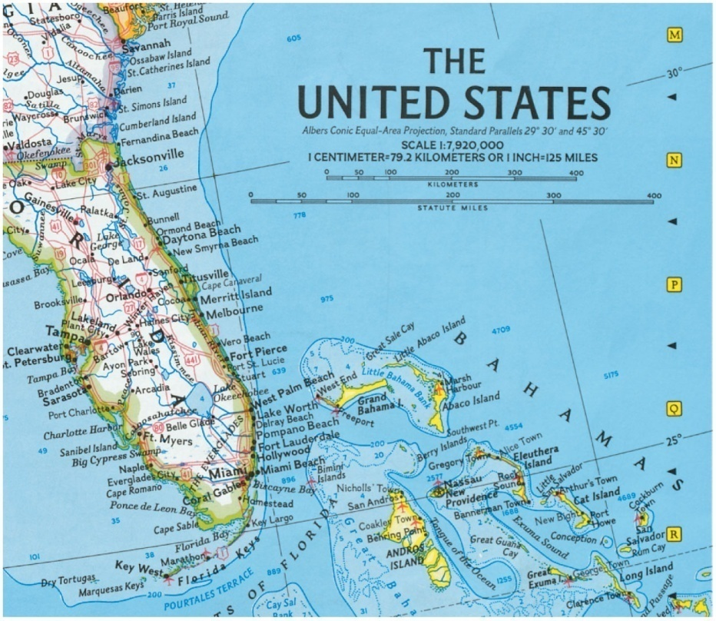

Map Scale
Maps are always smaller than the area they represent
Need map scales to help understand areal distances on maps
Scale is relationship between area on map and area on Earth
Three primary types
Graphic
Fractional
Verbal

Slide 3
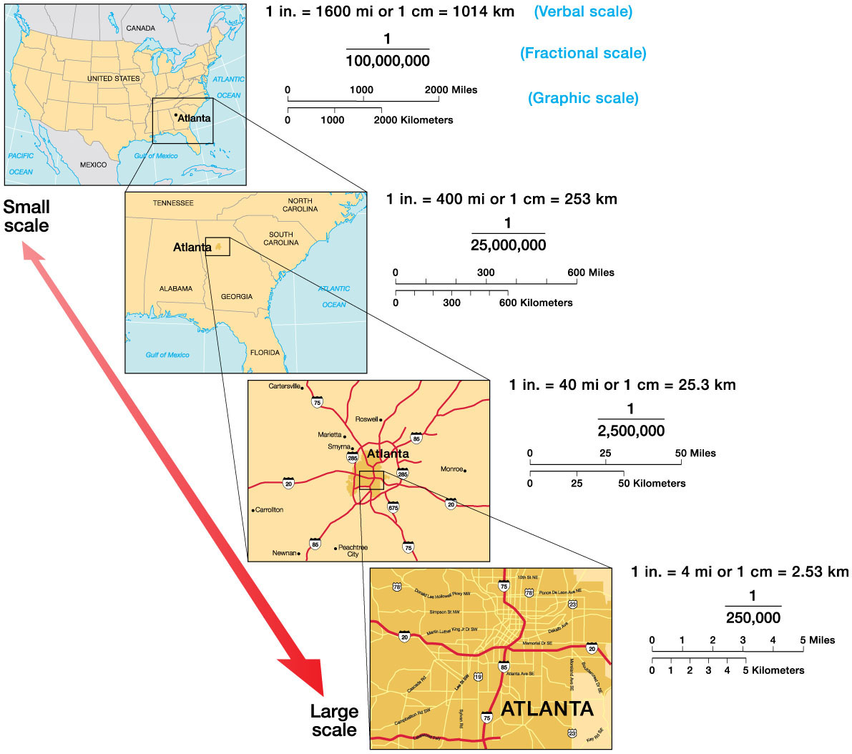

Map Scale
Large versus small map scales

Slide 4

Map Projections
Challenge of the cartographer (“mapmaker”)
Combine geographic exactness of globe with convenience of flat map
Always distortion
Three primary types
Equivalent – ratio of areal size on map and Earth is the same
Conformal – shape of locations on the map is the same as on Earth
Compromise - projections that are neither conformal nor equivalent, but are almost both (e.g. Robinson projection)
Animation page 35 -11 minutes.

Slide 5
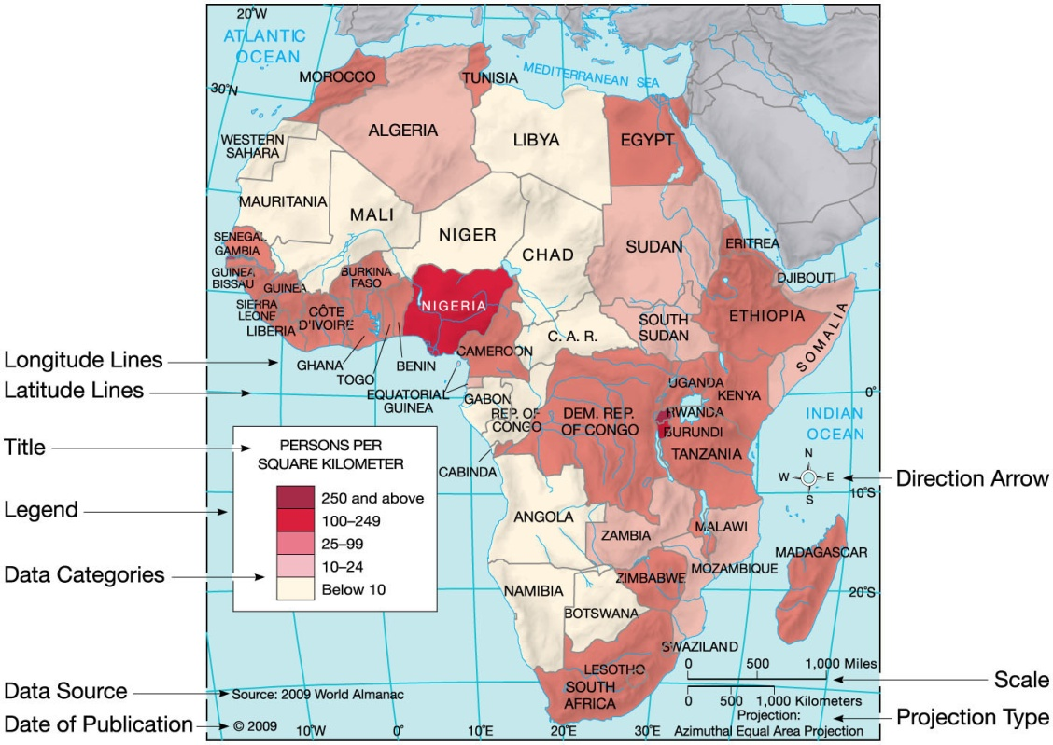

Conveying Information on Maps
Need several properties of maps to help with interpretation:
Title
Date
Legend
Scale
Direction
Location
Data Source
Map Projection

Slide 6
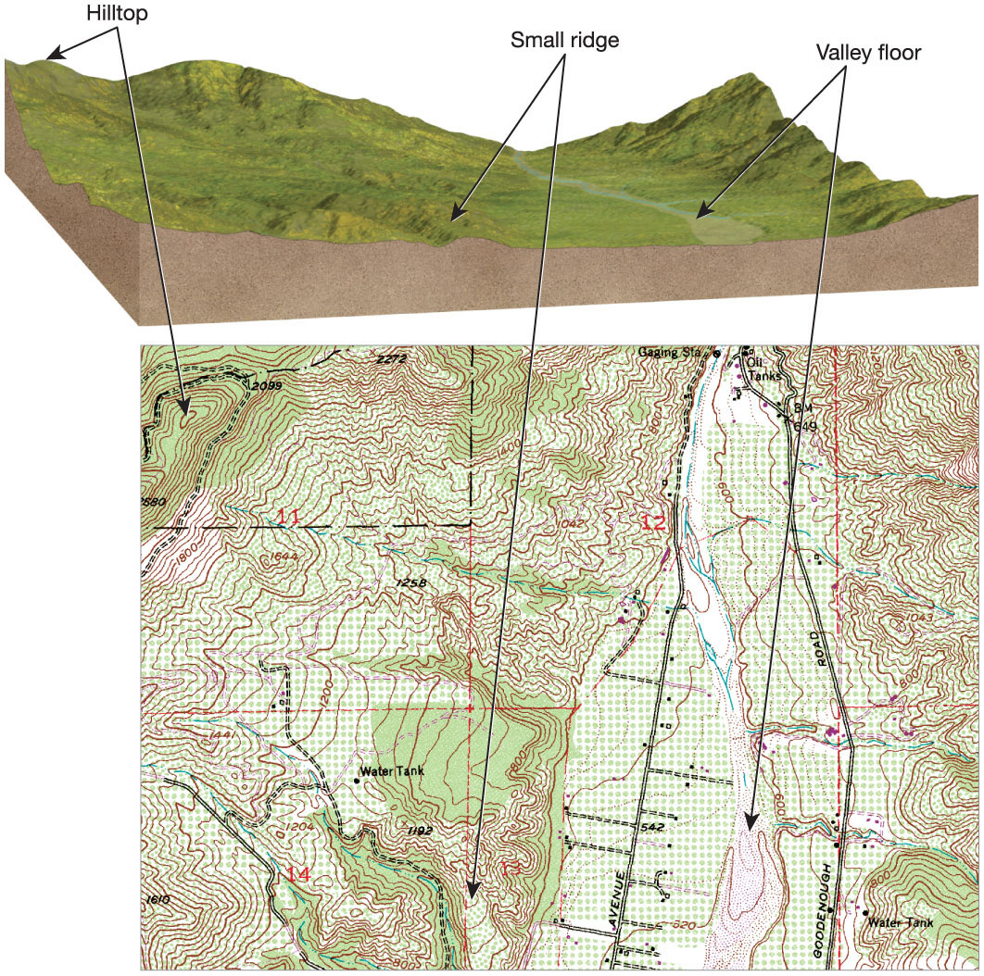


Conveying Information on Maps
Definition of an isoline
Many types
Elevation contour line – line of equal elevation
Isobar – line of constant pressure
Isotherm – line of constant temperature

